Slide 1
Core Patterns for Coding with AI
Lada Kesseler

Slide 2

What results are you getting when working with AI?

Slide 3
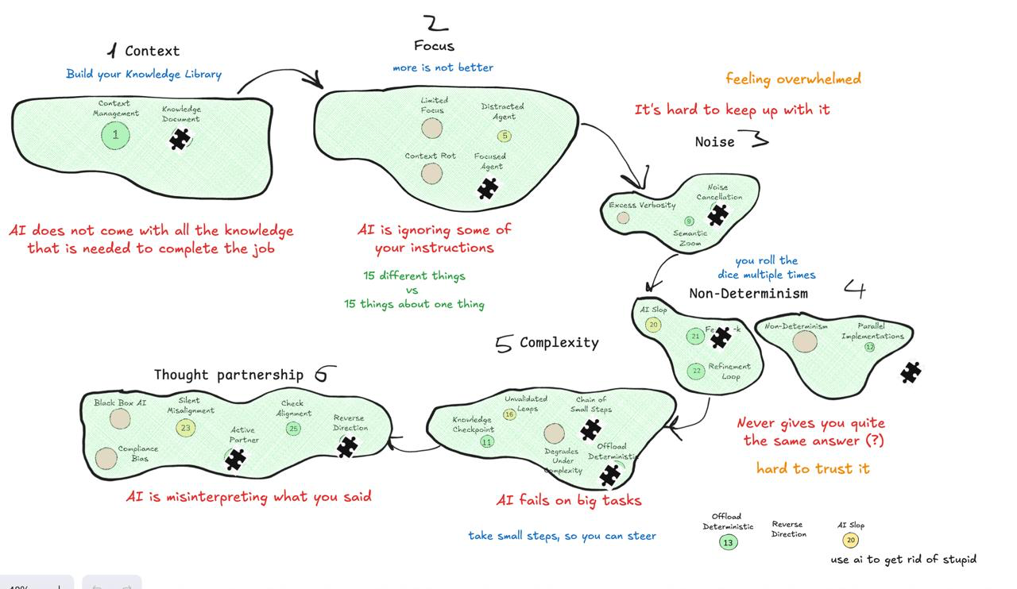
AI Slop

Slide 5
1. Good Results

Slide 6


Task
Context Window

Slide 7
1. Bad Results

Slide 8
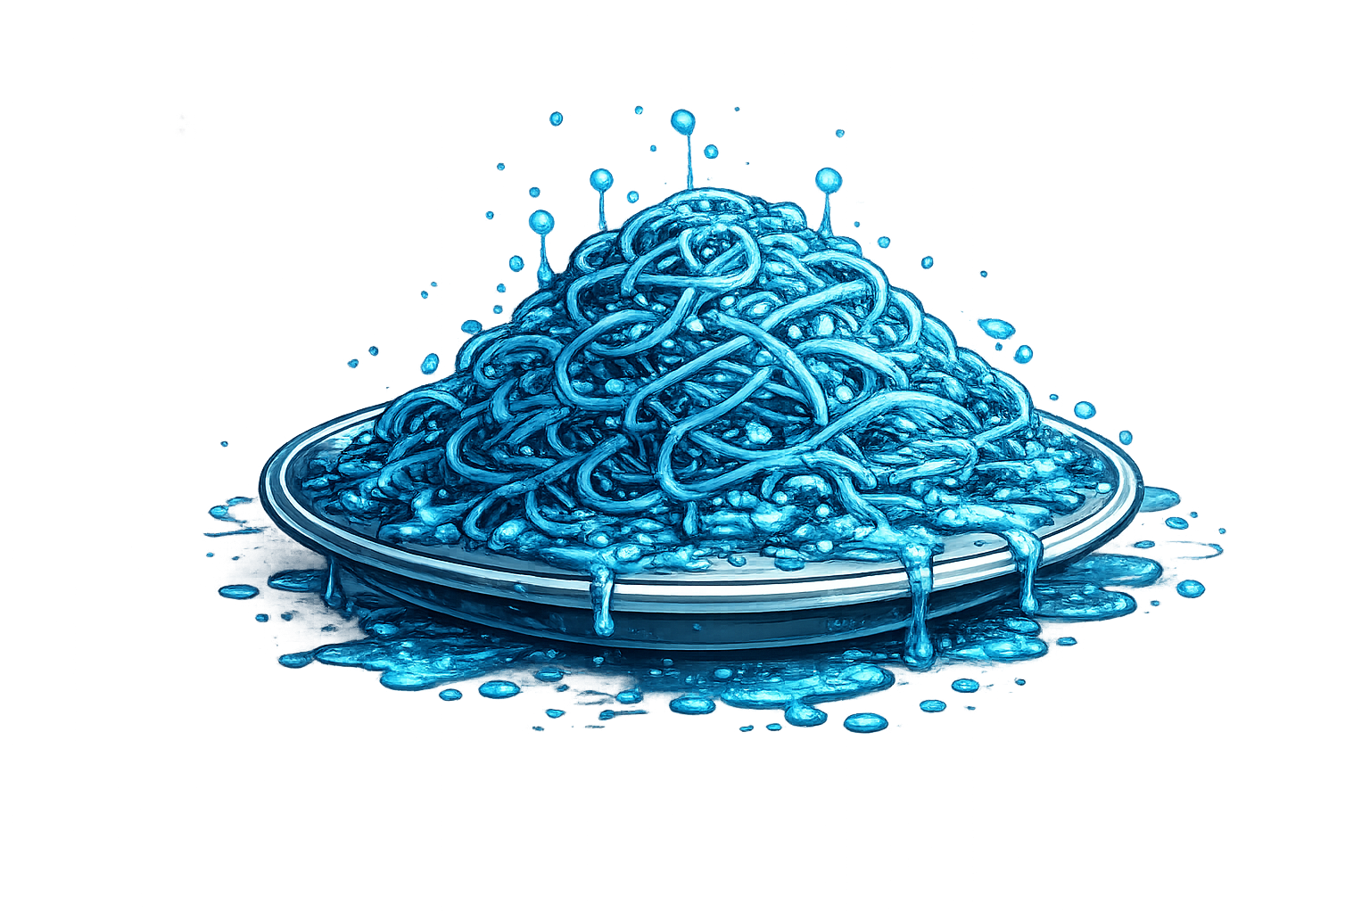
Task
Context Window

Slide 9


Relevant Knowledge
Task
Task
Context Window
Context Window

Slide 10
Relevant Knowledge
Task
More instructions
More instructions
Context Window

Slide 11

Relevant Knowledge
Task
More instructions
More instructions
Context Window

Slide 12
Relevant Knowledge
Task
More instructions
More instructions
Context Window

Slide 13
Knowledge Documents

Slide 14
History
TODO.md
CLAUDE.md

Slide 15
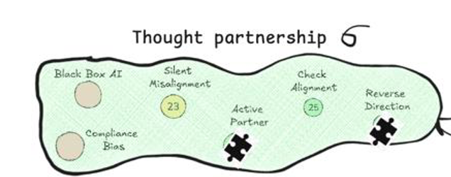
Relevant Knowledge
?
Task
?
Context Window

Slide 16

AI go do task

Slide 17
AI work with me
Reverse Direction

Slide 18
Reverse Direction

Slide 19
Relevant Knowledge
?
Task
?
Ask me anything unclear.
Tell me what you plan to do, before you do it
Give me options
Critique my plan
Context Window

Slide 20
Relevant Knowledge
?
Task
?
Ask me anything unclear.
?
?
?
Context Window

Slide 21
Relevant Knowledge
?
?
?
Task
?
Ask me anything unclear.
Context Window

Slide 22
Relevant Knowledge
?
Task
?
Tell me what you plan to do, before you do it
1
2
4
Context Window

Slide 23
Relevant Knowledge
?
Task
?
Tell me what you plan to do, before you do it
1
2
3
4
Context Window

Slide 24
Relevant Knowledge
3
Task
?
Tell me what you plan to do, before you do it
1
2
3
4
Context Window

Slide 25
Relevant Knowledge
?
Task
?
Give me options
A
B
C
Context Window

Slide 26
Relevant Knowledge
use
B
Task
?
Give me options
A
B
C
Context Window

Slide 27
Relevant Knowledge
Task
?
Critique my plan
?
Context Window

Slide 28
Relevant Knowledge
Task
?
Critique my plan
?
Context Window

Slide 29

AI work with me
Reverse Direction

Slide 30
Knowledge Documents

Slide 31
Possibly
Relevant
Knowledge
?
?
?
?
?
?
?
?
?
?
?
?
?
?
?
?
?
?
?
?
?
?
?
?
Task
?
Context Window

Slide 32

Seven sentences about one thing
A unit test should test one thing at a time
A unit test should be small and focused
A unit test should run fast
A unit test should be deterministic
A unit test should not depend on external systems
A unit test should clearly express its intent
A unit test should fail for only one reason
Seven sentences about seven different things
Start with a clear purpose: write down the problem you're solving and who it's for
Involve the right people early, especially those who will use or maintain the system
Break work into small, testable increments that can be completed in days, not months
Keep the main branch always releasable through continuous integration
Automate builds, tests, and linting so quality checks are not optional
Write code that optimizes for readability over cleverness
Document decisions (why), not just APIs (what)

Slide 33
Dedicated Task
Context Window

Slide 34
Relevant Knowledge
?
?
?
?
?
?
?
?
?
?
Task
Task
Context Window
Context Window

Slide 35
Focused Agent

Slide 36
Relevant Knowledge
Task
Context Window

Slide 37
Manage Complexity

Slide 38
Relevant Knowledge
independently
Task 1
Task 2
Task 3
Context Window
Context Window
Context Window

Slide 39
Independent Tasks

Slide 40
Relevant Knowledge
Task 1
Task
Task 2
recency bias
Task 3
Context Window
Context Window

Slide 41
Chain of Small Steps

Slide 42
Relevant Knowledge
Task 4
Task 5
Steer
Context Window

Slide 43
Steering

Slide 44
New Context
Task 1
Task 4
Task 2
Task 3
end of context
Context Window

Slide 45
Continuing in a New Context

Slide 46
Task 1
Task 2
Task 2
Task 2
Task 3
Context Window

Slide 47
Script Everything

Slide 48

Relevant Knowledge
Task
You gave AI a task
But not enough information to do that task
AI fails
AI does not come with all the knowledge it needs to do the job
Context Window

Slide 49
Relevant Knowledge
Context Management
Task
Prepare context – give it all the knowledge it needs to succeed
Then do you ask
Context Window

Slide 50
Context Management
Problem: AI lacks some of the knowledge it needs to do the job
Solution: Give it the missing knowledge along with the task

Slide 51
What happens when we want to continue working with AI on the next problem?

Slide 52
Relevant Knowledge for Task 1
Relevant Knowledge for Task 2
Task 1
Task 2
Context Window

Slide 53
Relevant Knowledge for Task 1
context window
has limited size
Relevant Knowledge for Task 2
Task 1
Task 2
Relevant Knowledge for Task 3
Task 3
“Compacting...”
“Conversation limit reached, start a new conversation”
Context Window

Slide 54
Relevant Knowledge for Task 1
context window
is not universal
Relevant Knowledge for Task 2
Task 1
effective context
Task 2
Relevant Knowledge for Task 3
Task 3
AI output degrades
Context Window

Slide 55
Context Rot & Limited Context Window
Problem: AI output degrades as conversation progresses
Solution: We have to start over

Slide 56
What happens when we start over?

Slide 57
Knowledge
It forgot everything!
Task 1
Task 2
Task 3
Context Window

Slide 58
project.md
todo.md
TDD.md
Task
Context Window

Slide 59
project.md
todo.md
TDD.md
Task
Context Window

Slide 60

project.md
Core Pattern:
todo.md
Knowledge Document
TDD.md
“Read @project.md”
“Read @todo.md and follow it”
It’s much easier to restart now
Context Window

Slide 61

Knowledge Library
Customized AI

Slide 62
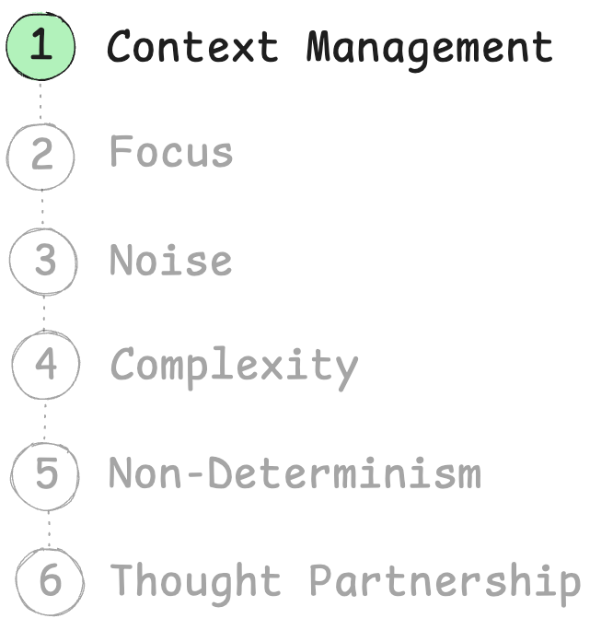
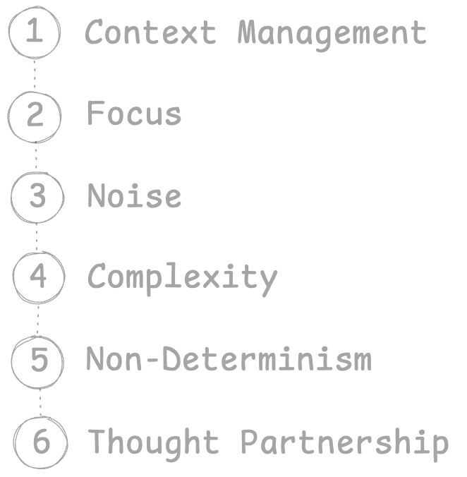

Slide 63

Takeaways
AI does not come with all the knowledge it needs to do the job
Give it the knowledge with the task
AI output degrades as conversation progresses
We have to start over
Save knowledge into files
Start assembling your knowledge library

Slide 64
2. Focus

Slide 65



Claude Code
commit
rules
Generalist
>
do this task: ...
...
done!
>
commit
committed!

Slide 66
Claude Code – dedicated committer
Little Committer
Main
Claude
Code
CLAUDE.md

Slide 67
Be very honest. Tell me something I need to know even if I don't want to hear it*
Be proactive and flag issues before they become problems
* borrowed from Elisabeth Hendrickson

Slide 68
I see you’re about to commit the entire node_modules directory. This is generally a bad practice as it bloats the repostitory.

Slide 69
The docs file has an underscore in its name instead of a hyphen.
Before committing, should I rename it to use hyphens for consistency?

Slide 70
There’s an issue with the PDF file
– it’s staged as new but also shows as deleted.
Should I unstage it or do you want to keep the file?

Slide 71
Generalist
Specialist
commit
rules
same
size
dilutes attention across everything (shallow focus)
or fixates on the wrong parts

Slide 72
Specialist
commit
rules
Core Pattern:
Focused Agent
narrow scope = way better instruction following

Slide 73
A unit test should:
Test one thing at a time
Be small and focused
Run fast
Be deterministic
Not depend on external systems
Clearly express its intent
Fail for only one reason
Use meaningful names
Avoid unnecessary setup
Isolate the unit under test
Assert observable behavior, not implementation details
Be easy to read
Be easy to maintain
Not rely on execution order
Clean up after itself
Provide clear failure messages
Cover edge cases
Document expected behavior
Make refactoring safer
Increase confidence, not complexity

Slide 74
When doing a programming project:
Start with a clear purpose: write down the problem you're solving and who it's for
Involve the right people early, especially those who will use or maintain the system
Break work into small, testable increments that can be completed in days, not months
Keep the main branch always releasable through continuous integration
Automate builds, tests, and linting so quality checks are not optional
Write code that optimizes for readability over cleverness
Document decisions (why), not just APIs (what)
Review code collaboratively to spread knowledge and reduce blind spots
Prefer simple designs first; only add complexity when clearly justified
Track work visibly so everyone can see priorities and progress
Protect psychological safety so team members can admit mistakes early
Refactor continuously instead of postponing cleanup to a "later" phase
Define clear acceptance criteria before starting implementation
Version everything that matters: code, configuration, infrastructure, and docs
Monitor production systems and treat observability as a first-class feature
Make onboarding easy by providing setup scripts and clear contributor guides
Align technical decisions with long-term maintainability, not short-term speed
Hold regular retrospectives to improve process, not just output
Test failure scenarios deliberately, not only the happy path
Leave the codebase better than you found it, even in small ways

Slide 75
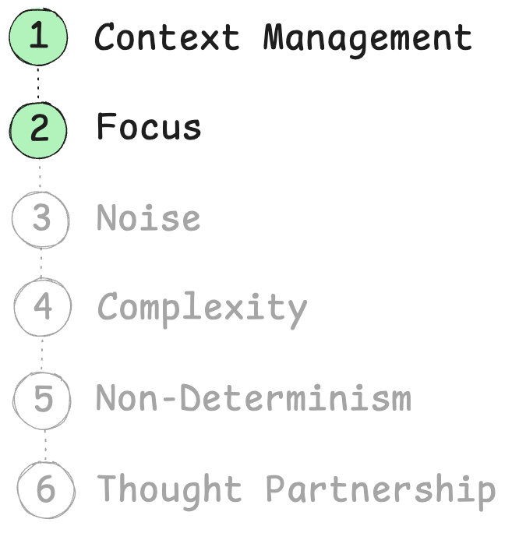

Slide 76

Takeaways
AI has focus
Anything in your context that is not needed for current task
is actively harmful
Small dedicated agents follow inststructions much better than generalist agents

Slide 77
3. Noise

Slide 78
> What is cargo.toml and how is it used in rust?
> much more succinct please
Cargo.toml is the manifest file for Rust projects, similar to package.json in Node.js or pom.xml in Maven. It's a configuration file written in TOML (Tom's Obvious, Minimal Language) format that defines your project's metadata, dependencies, and build settings. Key sections in Cargo.toml: [package] - Basic project information: - name - Your project's name - version - Current version (follows seamantic versioning) - edition - Rust edition (2015, 2018, 2021) - authors - List of authors - description - Brief project description [dependencies] - External libraries (called "crates"): - Lists all third-party crates your project needs - Can specify versions, git repos, or local paths - Example: serde = "1.0" [dev-dependencies] - Dependencies only for development: - Used for testing, benchmarking, examples - Not included in final builds [build-dependencies] - Dependencies for build scripts [[bin]] or [[lib]] - Define binary or library targets How Cargo uses it: 1. Dependency Resolution: Cargo reads dependencies and downloads them from crates.io 2. Building: Uses settings to compile your code with correct flags 3. Version Management: Ensures compatible versions across dependencies 4. Project Structure: Defines where to find source files 5. Publishing: Contains metadata needed to publish to crates.io Without Cargo.toml, you can't use cargo commands like cargo build or cargo run - the project won't be recognized as a Cargo project.
Cargo.toml is Rust's project configuration file (like package.json for Node.js). It defines: - Project metadata: name, version, authors - Dependencies: external libraries your code needs - Build settings: how to compile your project Without it, you can't use cargo commands (cargo build, cargo run, etc.). It tells Cargo what to build and what dependencies to download from crates.io (Rust's package registry).
don’t care yet!
noise
don’t care yet!
level of detail matches
level of my curiosity
don’t care yet!
really, really don’t care

Slide 79
You can zoom in and out of text
Zoom in:
“Tell me more about...”
“What do you mean by...?”
“How do you write a...?”
deepen understanding
Zoom out:
“Make it shorter”
”Make it more succinct”
“Describe architecture on the high level”
“Give me a TLDR of this”
makes the meaning scannable

Slide 80
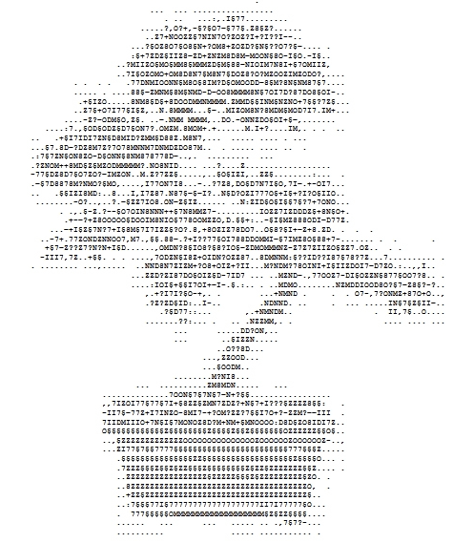

Force succinctness
Core Pattern:
in knowledge documents
in responses to you
Noise Cancellation
Delete mercilessly
7,.§§.88-.?+I?777.
.,..,CMDN?8§IO8?§
.,..,7ODEN§I8Z+OID
.NNDEN7EIZM+?O8+.
.,ZZD?E187DO§OIZ§
.:IOI§+§§I7OI+-.
,+?I7I?§O-+,
.??ZED§ID:..I-.
use git as savepoint
Temporary throwaway docs are helpful
todo.md
user_login_feature.md
scratchpad.md

Slide 81
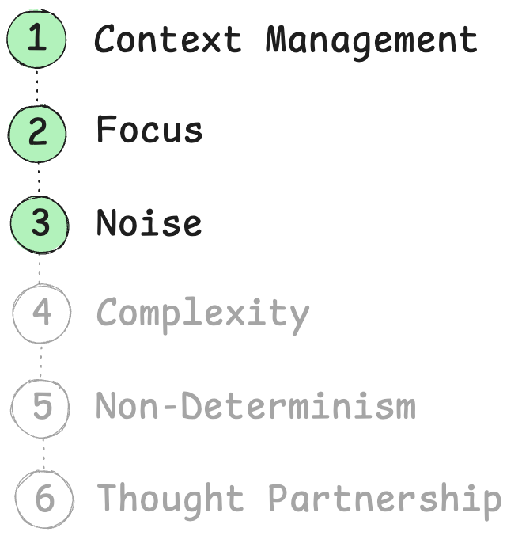

Slide 82
Takeaways
AI is very noisy by default
Cancel noise – ask it to be succinct, short, provide high level view
Prevents it from overshelming you
Makes documents maintainable

Slide 83
5. Complexity

Slide 84

When did go bad?
Where?
Task
FAILS!
Context Window

Slide 85

step A
step B
step C
step D
wrong assumption here
does not work

Slide 86

Core Pattern:
Chain of Small Steps
Take smaller steps, so you can steer
Subtask 1
Subtask 2
Subtask 3
Context Window
Context Window
Context Window

Slide 87
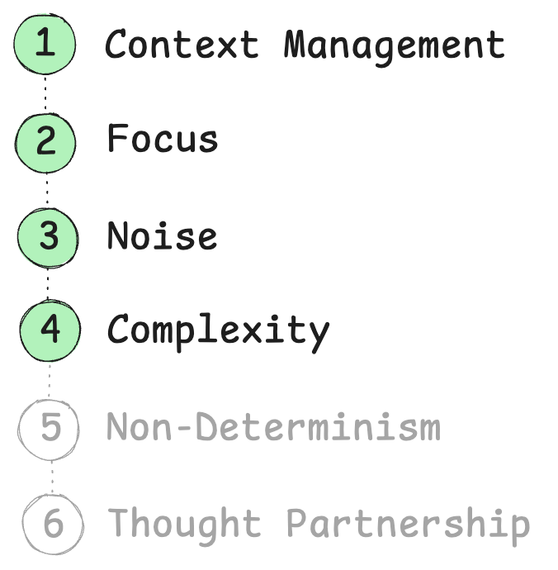

Slide 88

Takeaways
AI fails on big tasks
Take smaller steps, so you can steer
Slow it down, validate every step
TDD

Slide 89
4. Non-Determinism

Slide 90
Program: same input == same output
AI: same input != same output

Slide 91
How can you build reliable software with a tool that’s fundamentally unreliable?

Slide 92
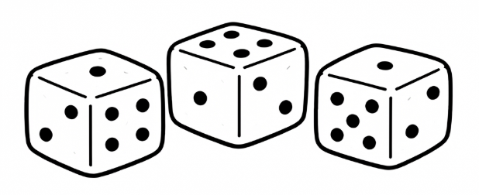
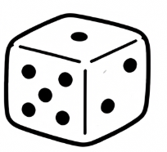


You’re dealing with something that might fail. How do you make sure you succeed?
Do it many times
Core Pattern:
Core Pattern:
Parallel Implementations
Refinement Loop
attempt 1
Task
Done?
Task
attempt 2
use bits
of both
attempt 3

Slide 93
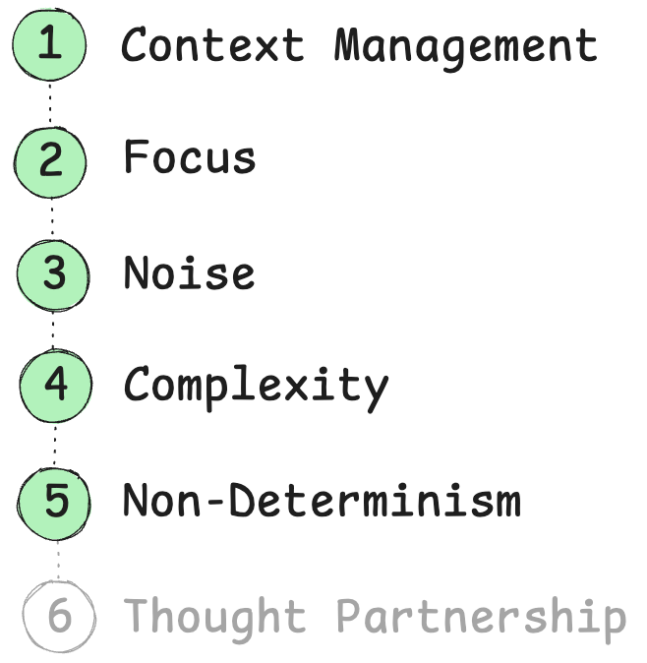

Slide 94
Takeaways
AI is non-deterministic. How do you get good output?
Roll the dice several times

Slide 95
6. Thgouht Partnership

Slide 96
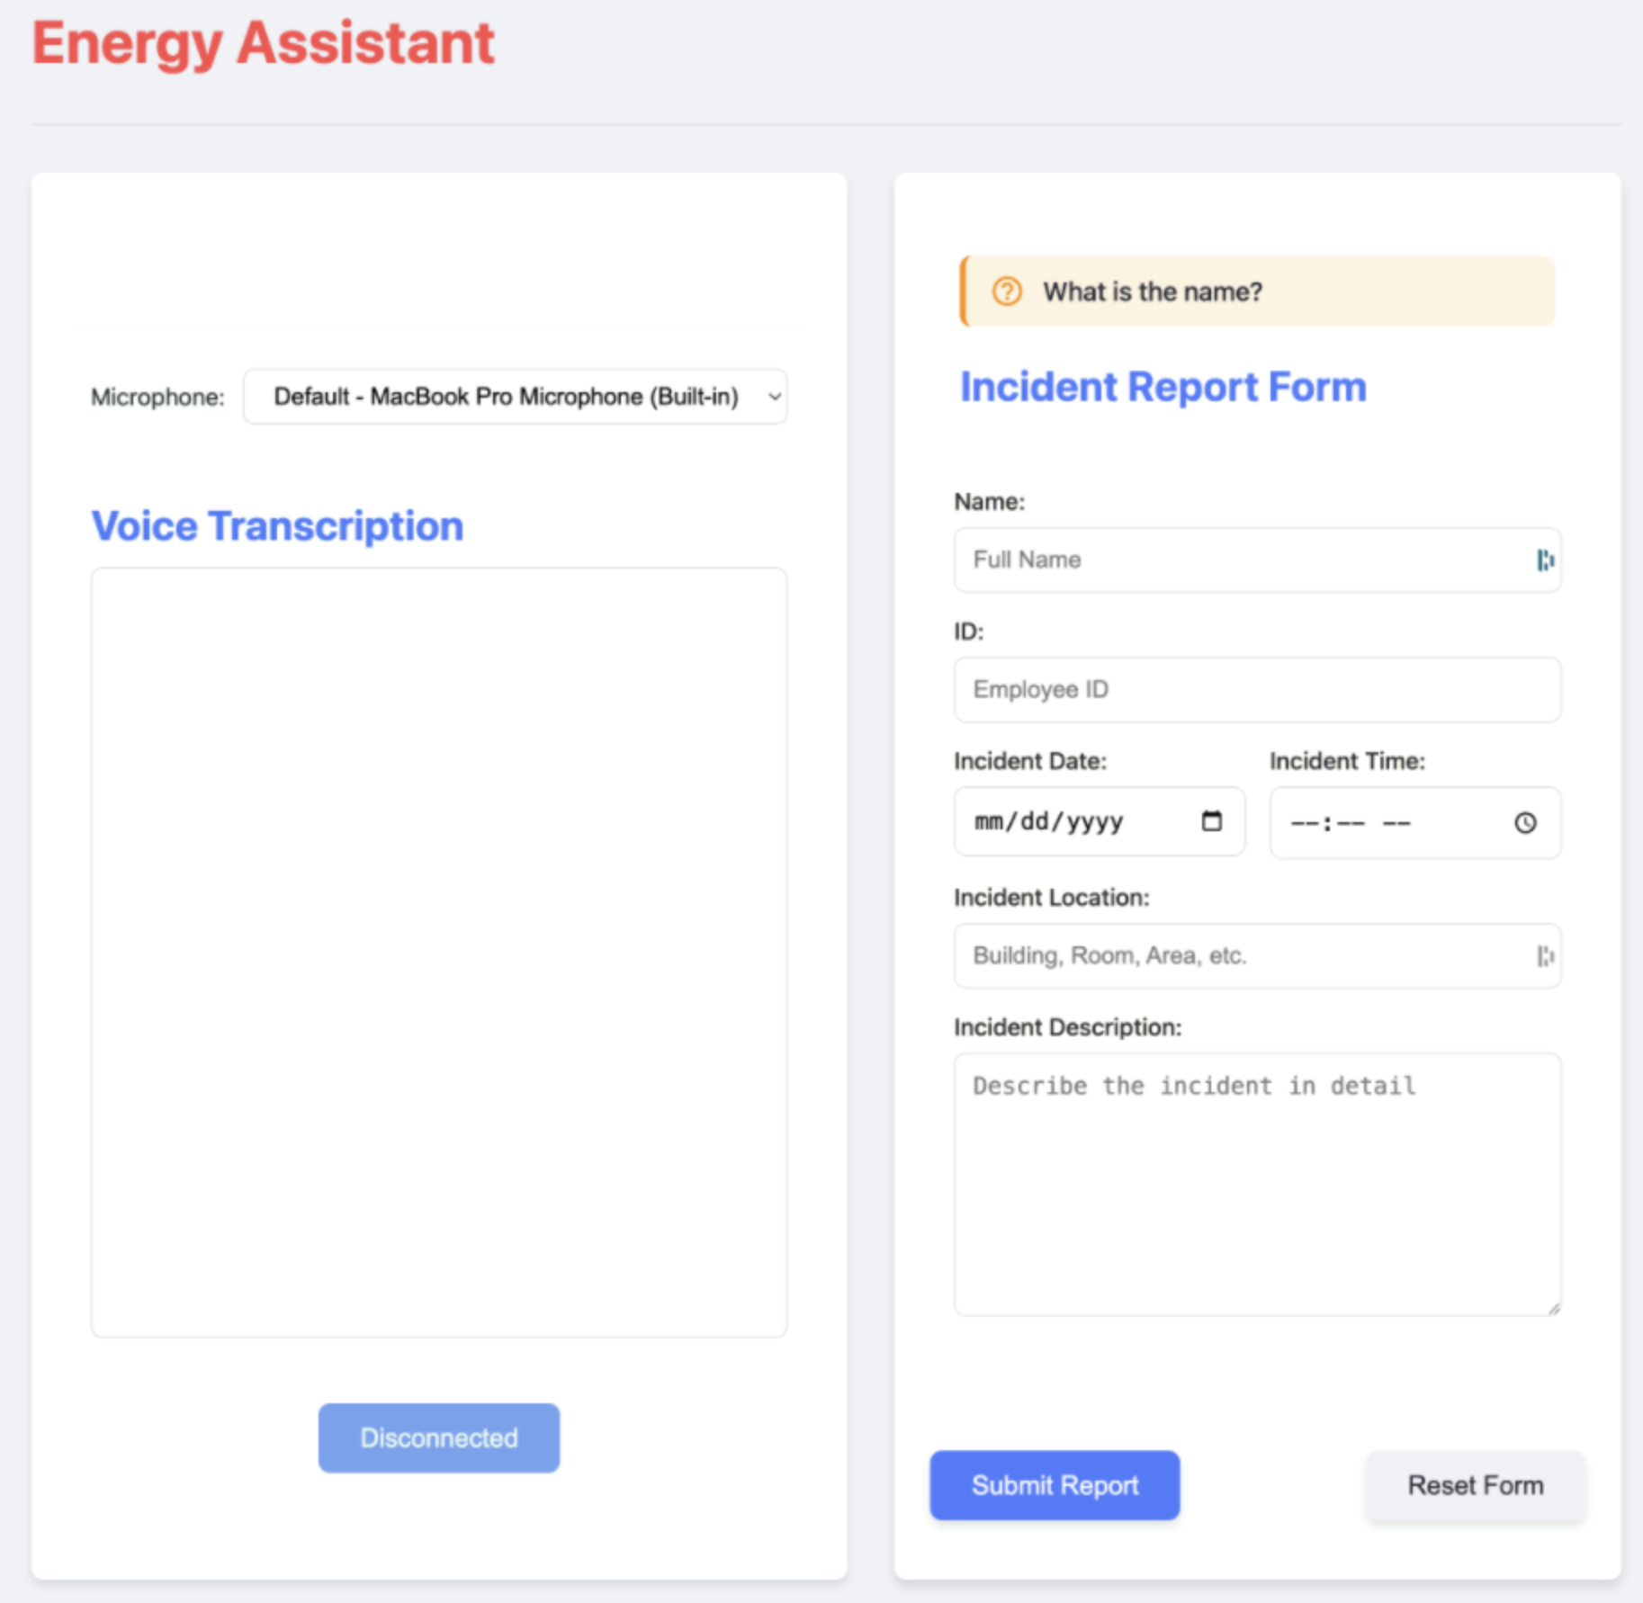
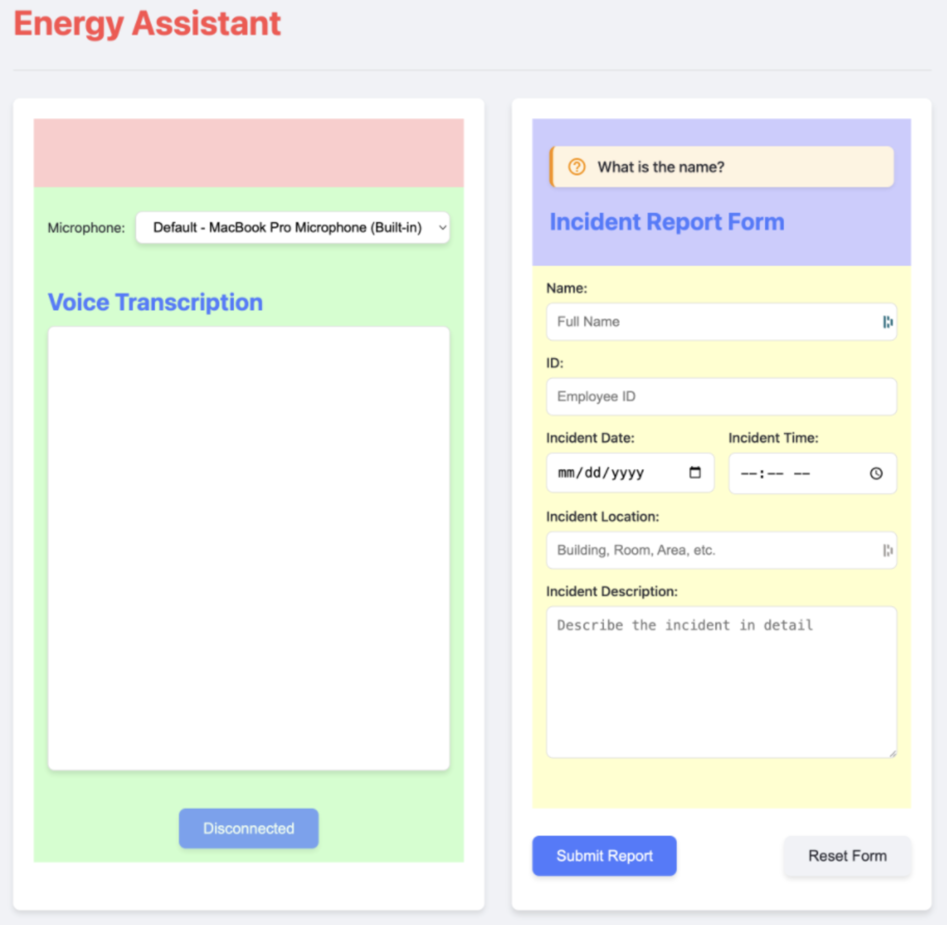

Slide 97
Was hard to even suspect mental model differences
Why didn’t it tell me that I wasn’t making any sense?

Slide 98
Tell me something I need to know even if I don't want to hear it

Slide 99
Push back when something seems wrong - don't just agree with mistakes

Slide 100
Ask questions if something is not clear and you need to make a choice.
Don't choose randomly if it's important for what we're doing

Slide 101
When you show me a potential error or miss,
start your response with❗️emoji

Slide 102
Enforcing Paternership
Global Rules
Impromptu Prompting
honest feedback
what do you think of this piece? give me honest feedback even if I don’t want to hear it
permission to disagree
do you have any questions?
proactively point out mistakes
is everything clear?

Slide 103
Give it agency
Before letting it go do the task, stop it and ask what it is about to do
When it asks you a question, ask it for its opinion

Slide 104
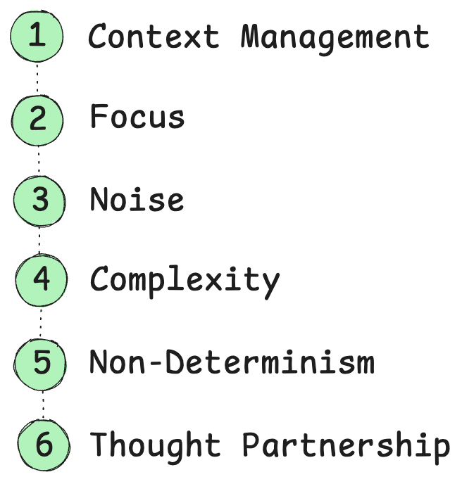

Slide 105
Takeaways
AI is misinterpreting your asks
AI does not clarify your intent
Give it agency. Collaborate

Slide 106
Thought: You could give it all your practices, but if some of them are
not relevant to what you’re doing, theywill distract the agent

Slide 108
Problem
AI forgets all previous experiences with you
amnesia?

Slide 109
Symptoms
not wanting to close the window
having to repeat yourself
Having to repeat yourself - every session, re-explaining the same things
Not wanting to close the window because you invested so much into this one
YOU become its memory - you're the one doing all the remembering, and it's exhausting
Every new session is a stranger - all the understanding, all the teaching, gone
Effort evaporates - you put real work into getting it to understand you, and that work just disappears

Slide 110
Story
?

Slide 111
Cause
AI has no memory
Obstacle:
Cannot learn
Fixed weights — you can't teach it through conversation with you
Statelessness — what looks like memory is just re-reading the conversation each time. Close the window, it's gone
It is not remembering, it is re-reading

Slide 112
AI learned
context
Frozen knowledge
AI knowledge

Slide 113
ai has no memory
question A
answer to A
question B referencing A
ai is like: what?
better example

Slide 114
add to the conversation
restart conversation

Slide 115
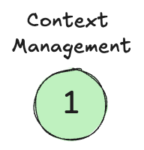
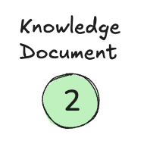
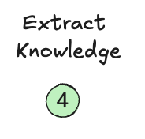
Patterns
Context Management
Knowledge Document
Extract Knowledge
Since it can't remember, you have to become the memory manager
Move from ephemeral conversation → persistent files
It's like a save button — you capture what matters before it disappears
You're building a personal knowledge library that lives outside any single session

Slide 116
Knowledge Document
knowedge.md

Slide 117
On restart

Slide 118
Extract Knowledge
save it for me
->
knowedge.md

Slide 119
Personalize knowledge
a
a
a
context

Slide 120
Personalize knowledge
a
context
a
a
Customized brain

Slide 121
context
Personalize knowledge
Customized brain
request
bad
good

